Slide 1
Network analysis of protein-protein interactomes
Dingjue ji, Hussein mohsen, and amy zhao

Slide 2
Investigating the human protein-protein interactome
Provides an exploration of the functional aspects of the human proteome
Human Protein-Protein Interaction (PPI) files were downloaded from two databases:
Molecule INTeracting Database (MINT)
Database of Interacting Proteins (DIP)
Notes:
Human protein-protein interaction (PPI) networks provide valuable insight into the functionality of proteins beyond what is detailed in the human proteome.
For project 3.1, protein-protein interaction (PPI) data were downloaded from two different databases: The Database of Interacting Proteins (DIP) and the Molecular Interaction Database (MINT). We filtered the edges where one or two of the proteins did not have the UniProtID, which constituted less than 5% of the total proteins of interest. The former database generated 4904 distinct proteins with 7,387 interactions, while the latter yielded 4584 distinct proteins with 12,655 interactions.

Slide 3
Project AIMS
Visualize the PPI networks obtained from the two databases
Propose a tool that calculates measures of centrality and compare to output from Cytoscape
Determine distribution of degree centrality and betweenness centrality for PPI networks
Characterize any statistically different significant differences between proteins containing and not containing SNPs in Carl’s genome
Perform hierarchical analyses on the PPI networks
Notes:
In this project, we hope to visualize the structure of the human PPI network - which was obtained from two different databases - as well as determine the distribution of the degree and betweennness centrality measurements for the proteins within said network, using both our own proposed tool as well as the bioinformatics software Cytoscape. Furthermore, we would like to characterize any statistically significant differences between the proteins containing and not containing SNPs in Carl's genome. Finally, we also perform a hierarchical analysis of the PPI network.

Slide 4
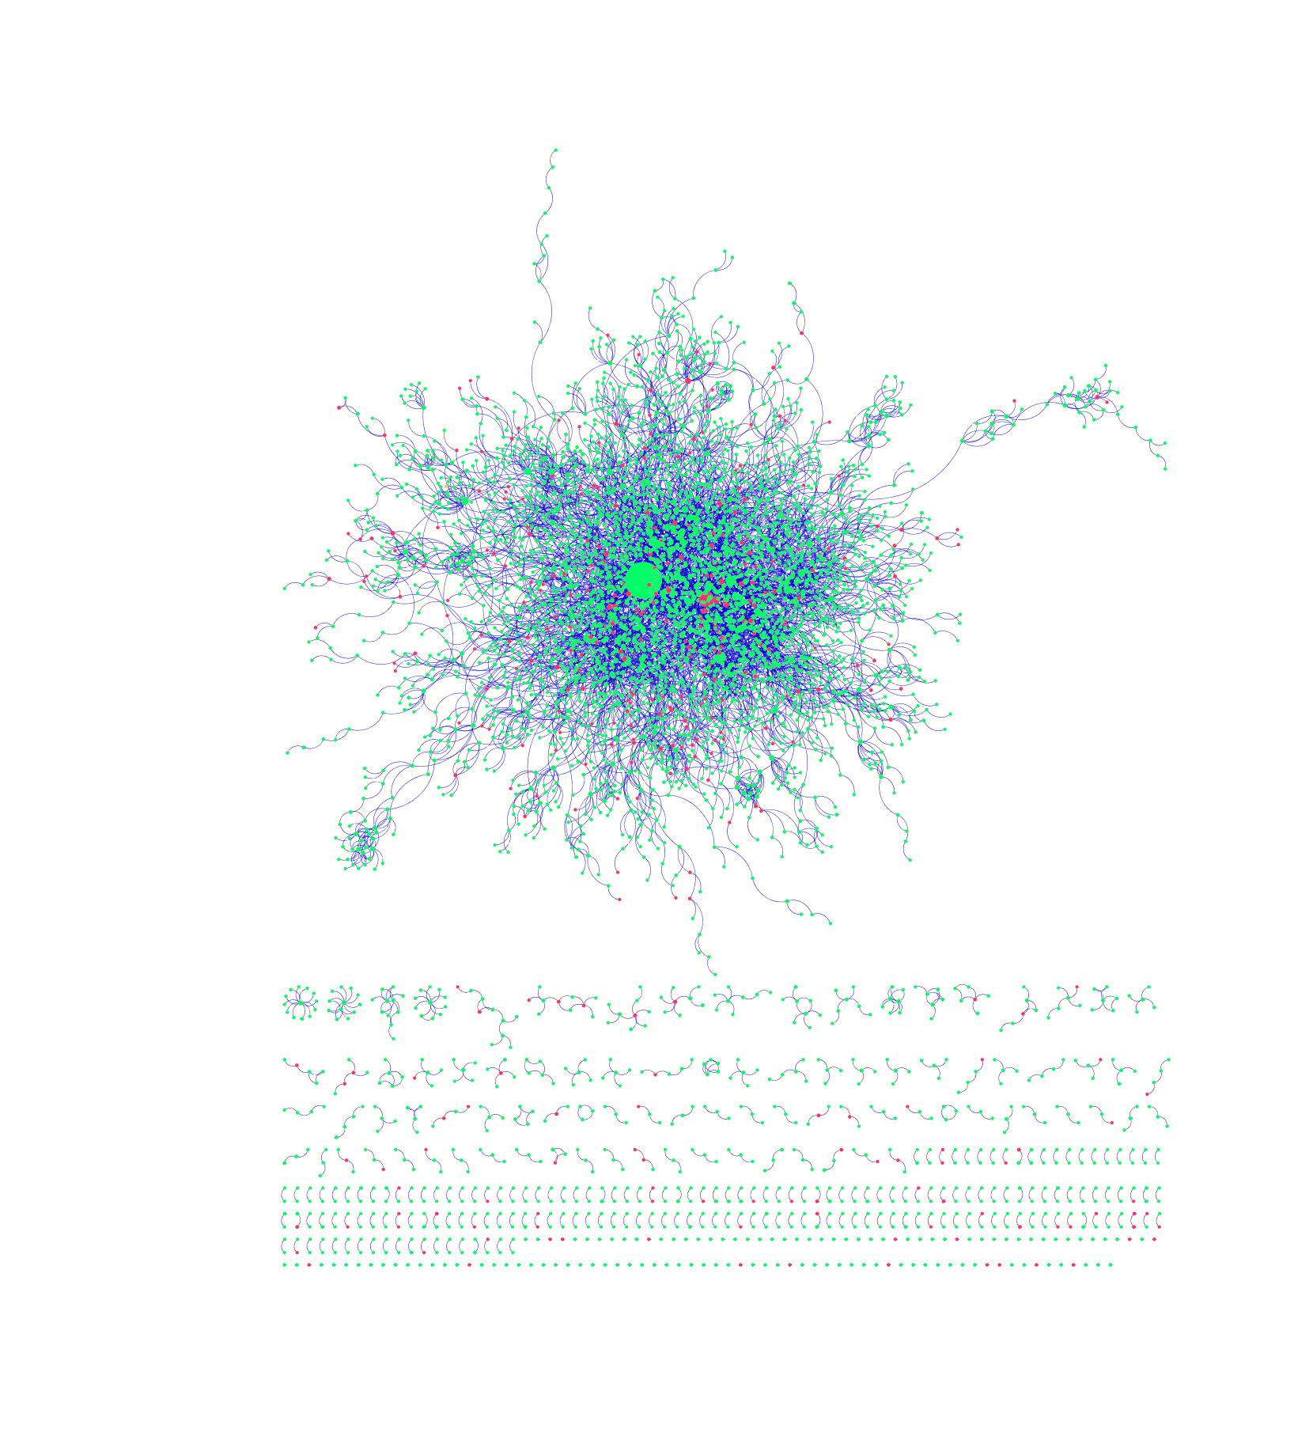
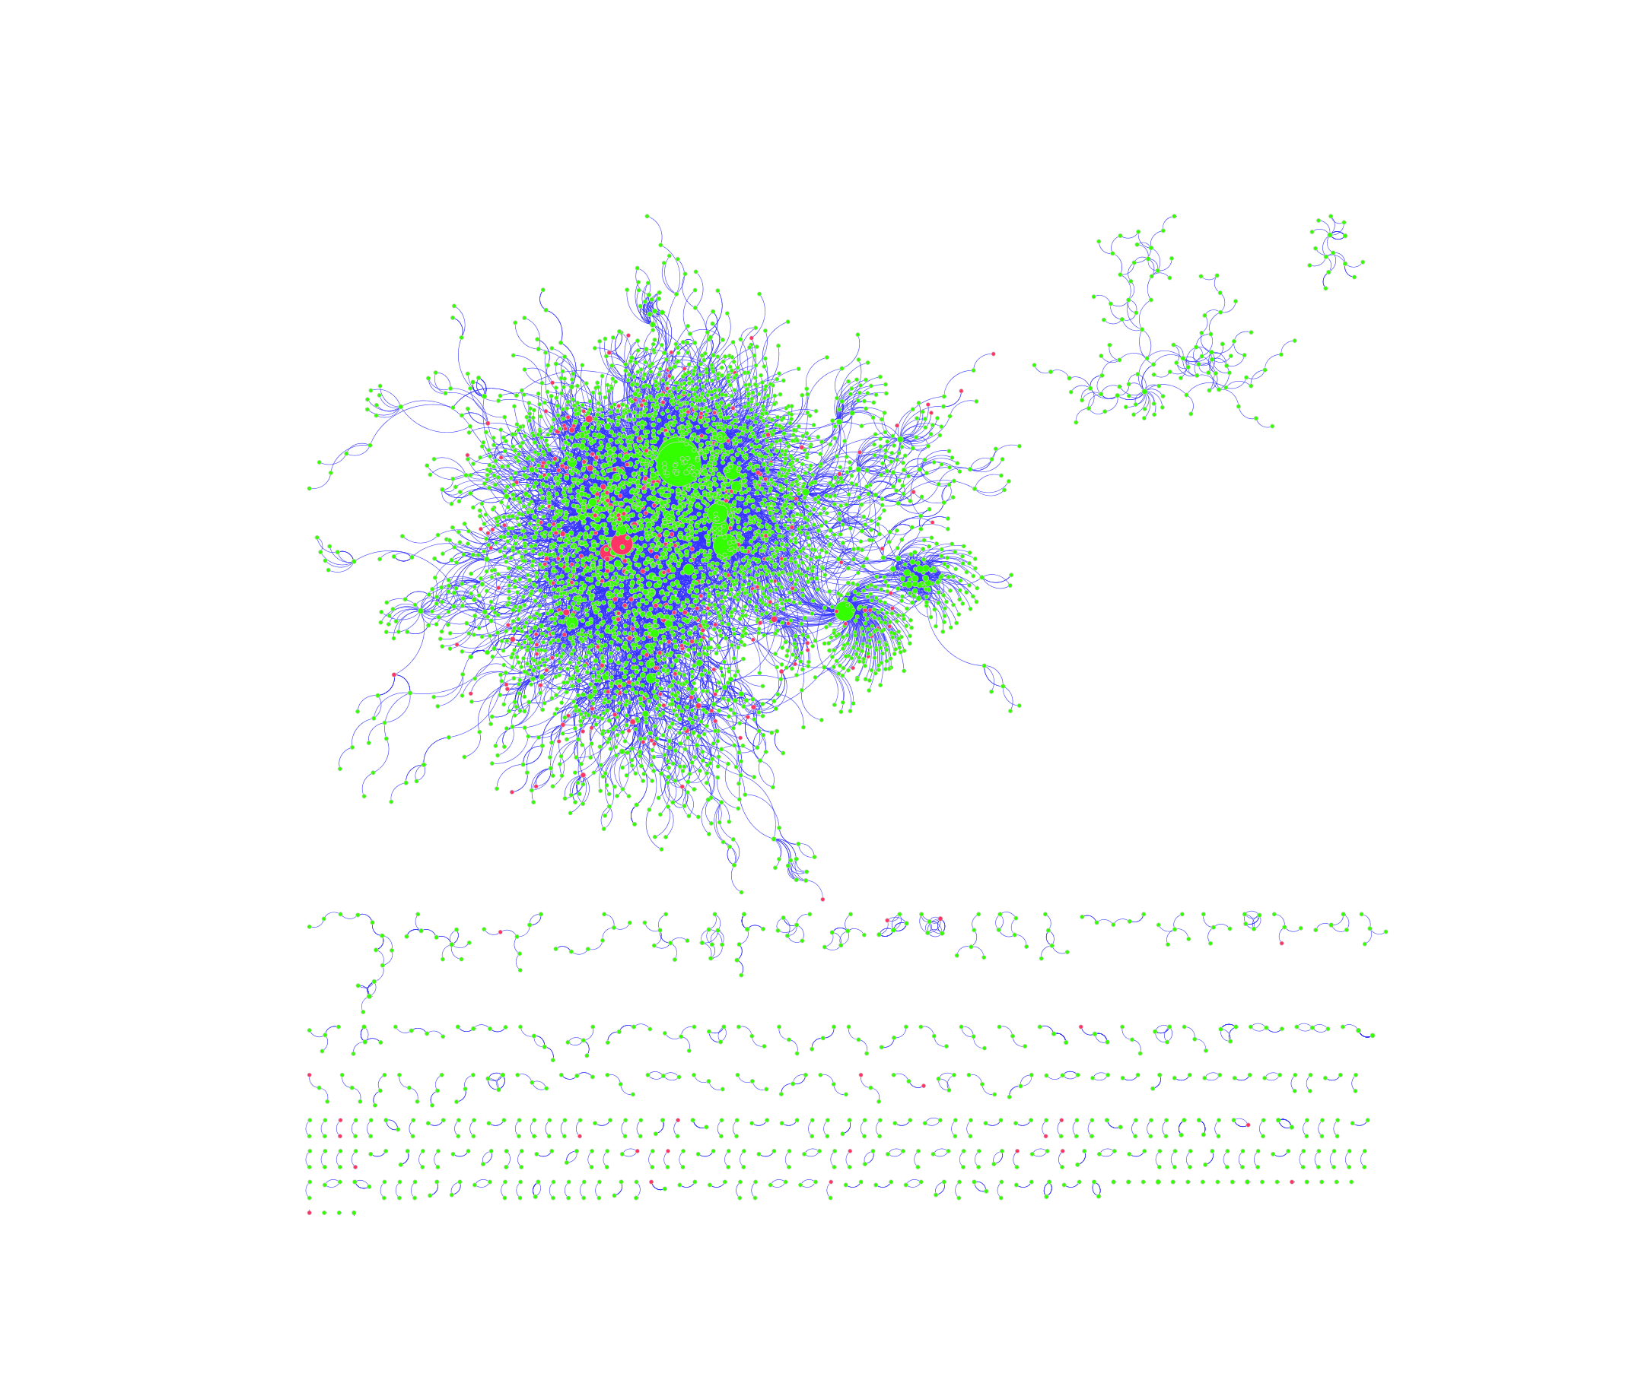
Visualizing the ppi network
DIP
MINT
Notes:
The interactions between different proteins can be best represented by an undirected graph, where the individual proteins are represented by nodes and their mutual interactions are represented by links. The corresponding graphs generated from the protein-protein interactions catalogued in the DIP and MINT database were created by the bioinformatics software platform Cytoscape (see Figures 1 and 2, respectively). Green nodes represent proteins that do not contain SNPs in Carl’s genome, whereas red ones represent proteins that do. Links are characterized by blue edges. Moreover, node size is directly proportional to the degree of said node; namely, bigger nodes have more links and are thus more likely to be characterized as “hubs”. Finally, different network motifs are summarized at the bottom of png images.

Slide 5

Measures of centrality
Measures of centrality can identify the most important nodes within a network
We looked at two different measures of centrality. Given a graph G:=(V,E):
Degree centrality of node n:
$C_{D}\left(n\right)=deg⁡(n)$
Betweenness centrality of node n, summing over distinct nodes l and m:
$C_{B}\left(n\right)= \sum_{l≠m≠n∈V}{\frac{σ_{lm}\left(n\right)}{σ_{lm}}}$
Notes:
Next, the degree centrality and betweenness centrality measurements were calculated for each node. It is first important to define these two measures. The former is equivalent to the number of the links a node has. On the other hand, the betweenness centrality is defined as the number of times a node is located on the shortest path between two other nodes. In mathematical terms, the two measures are defined as shown by the slide.

Slide 6
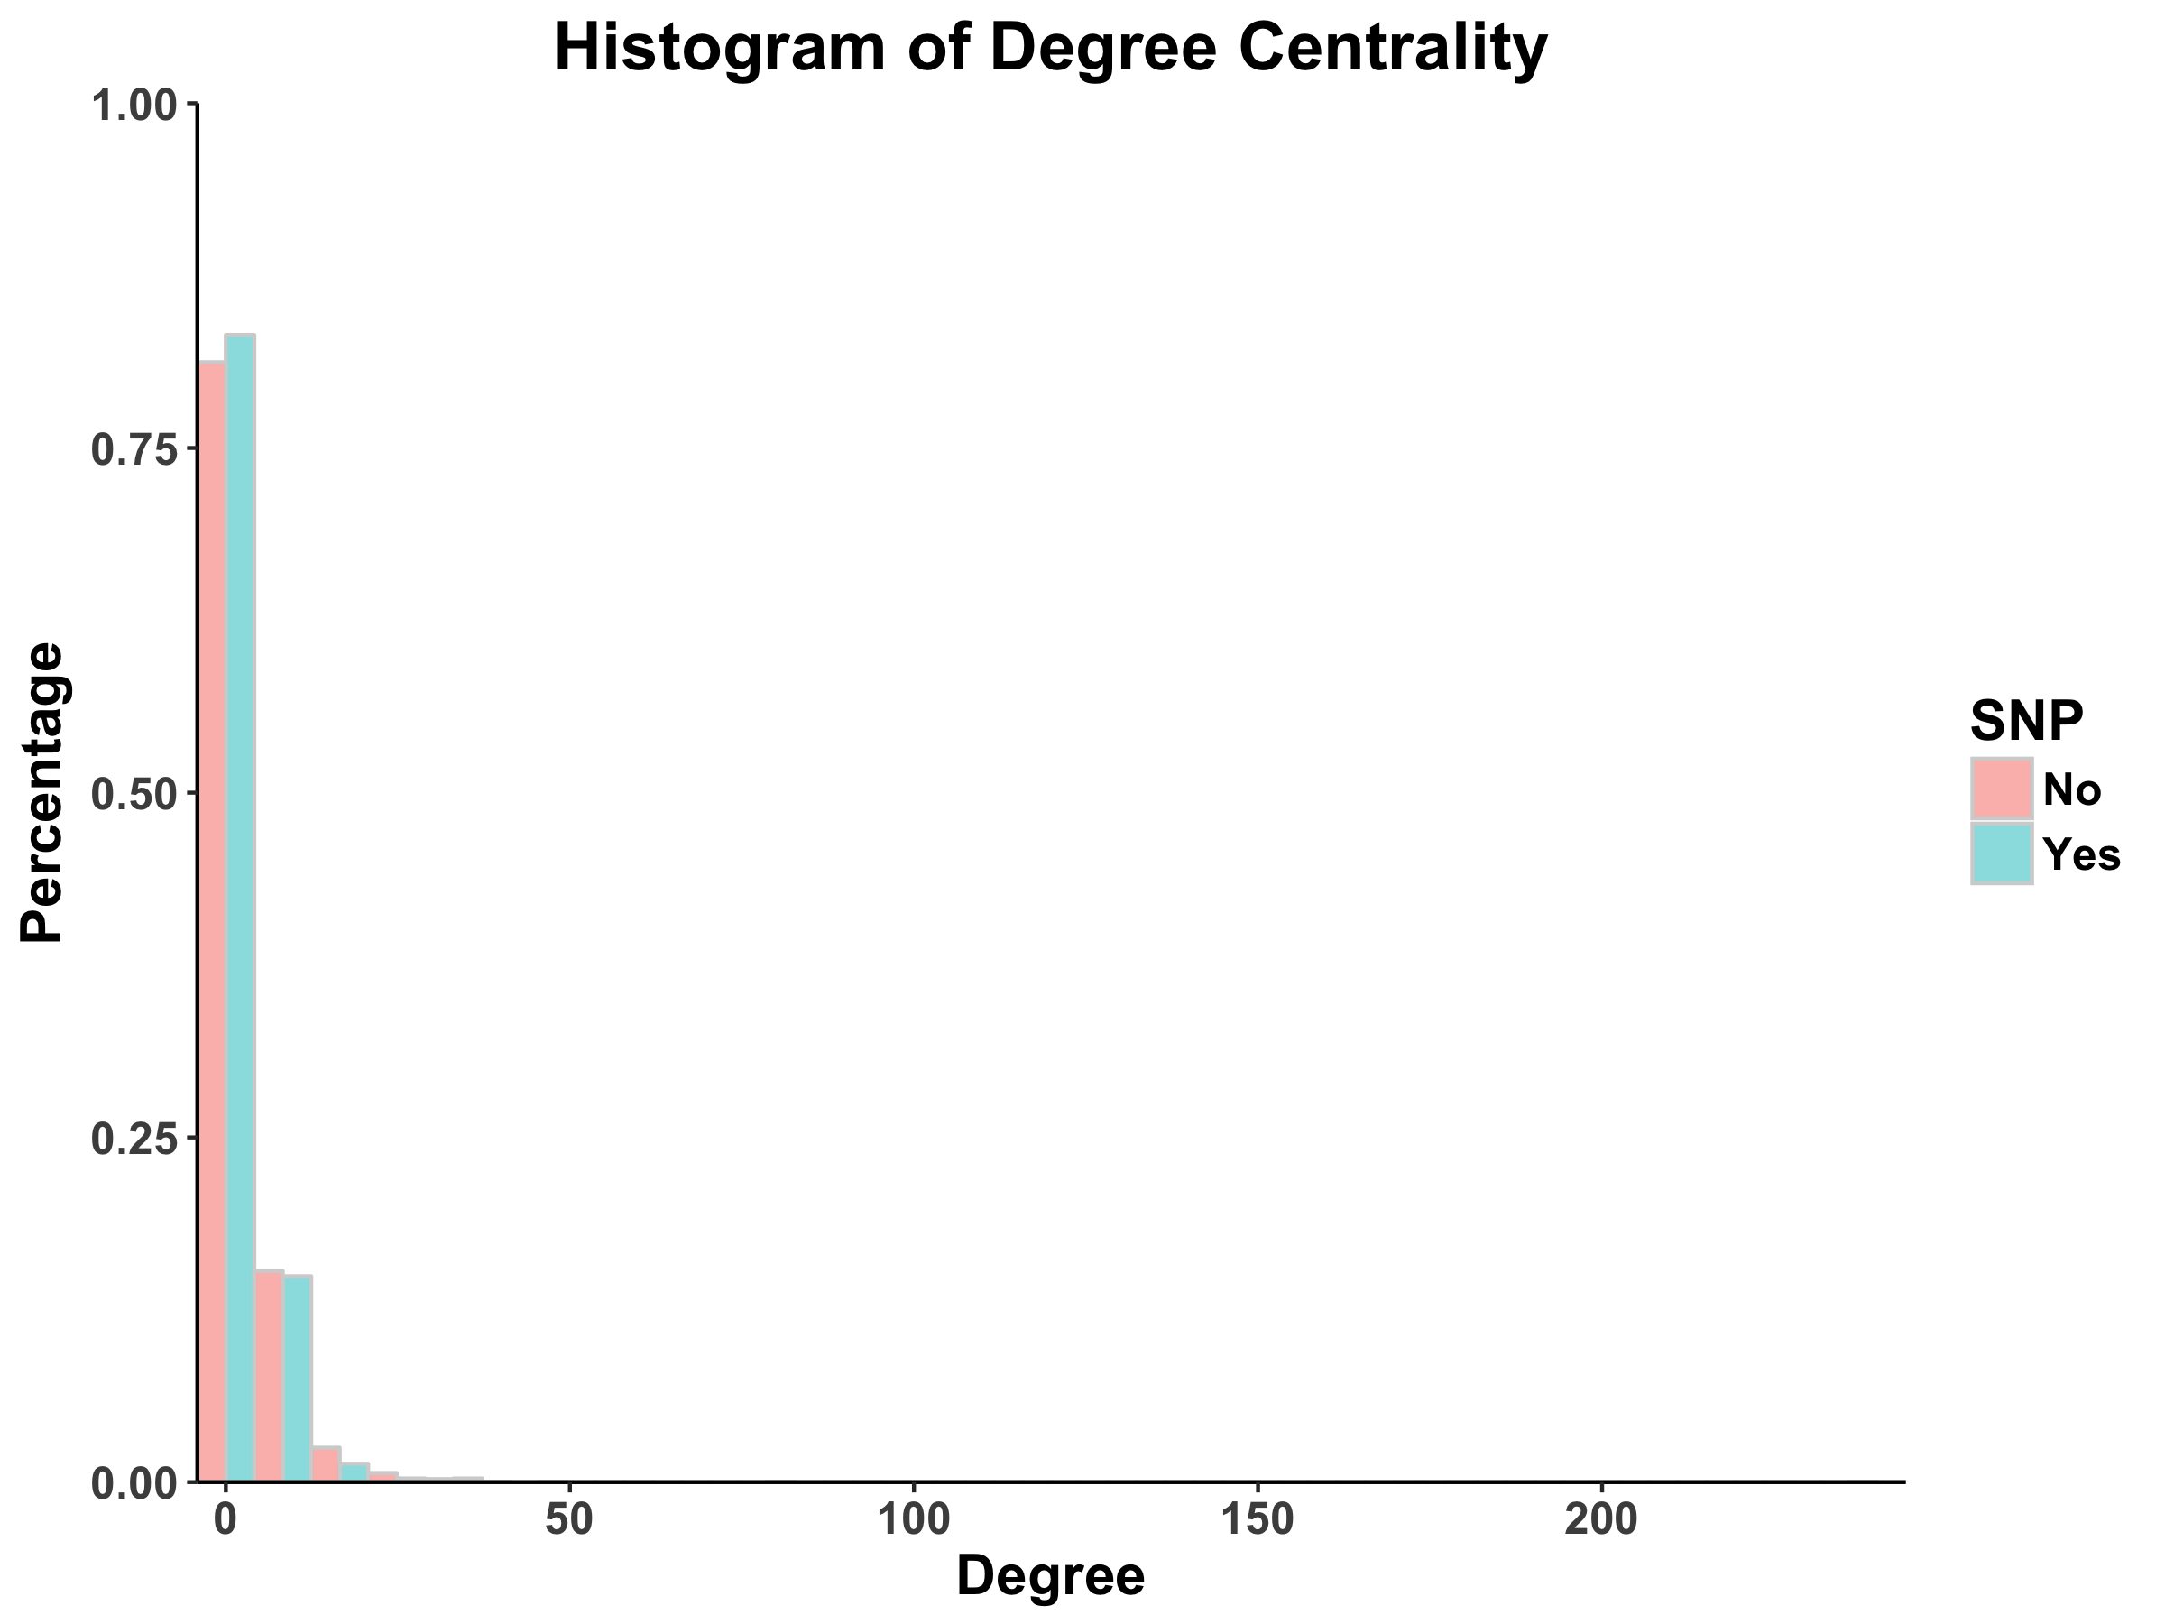
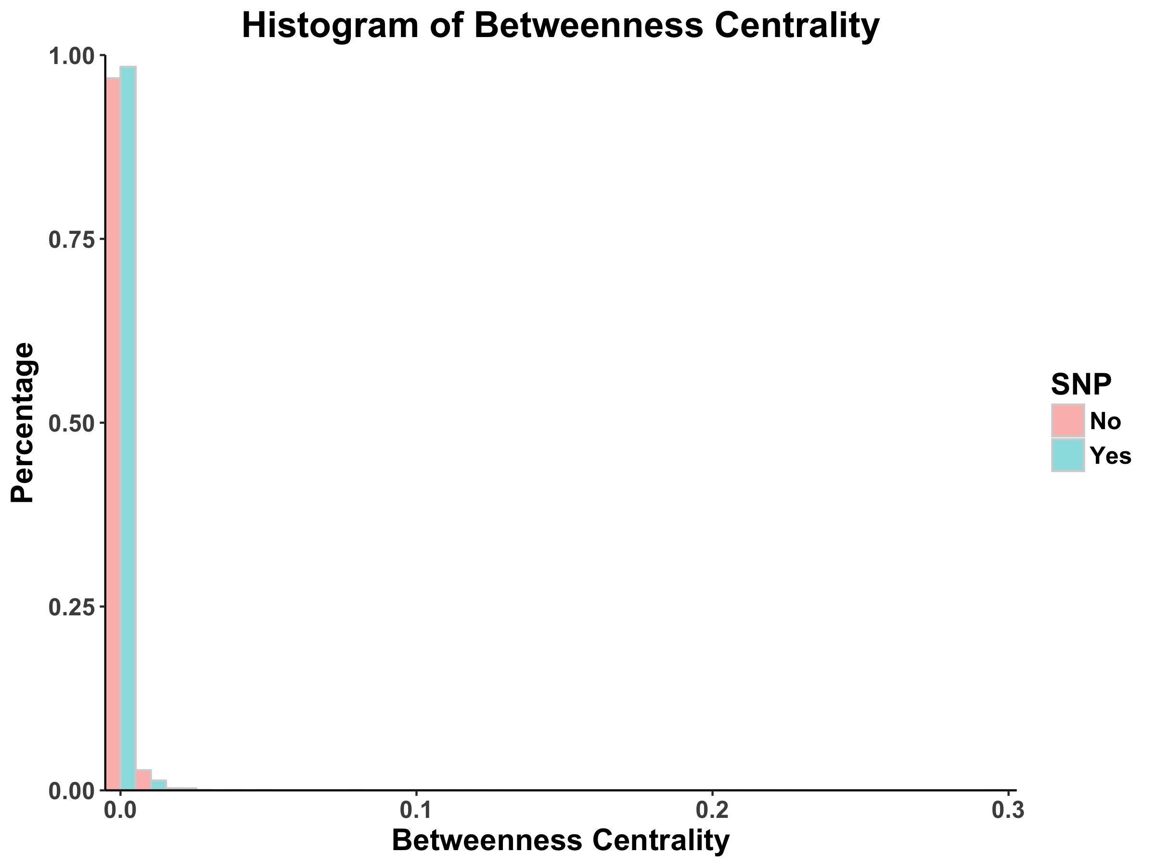
Cytoscape-generated distributions of centrality measures
Notes:
The degree centrality and betweenness centrality for each node was calculated by Cytoscape’s functionalities. Here, we use the network from DIP as an example

Slide 7
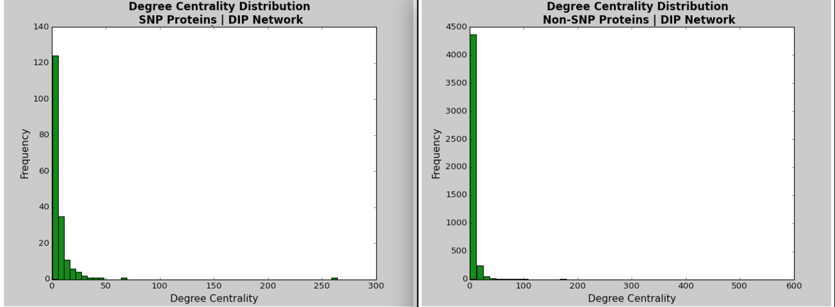
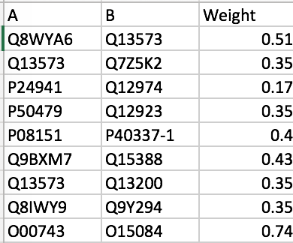
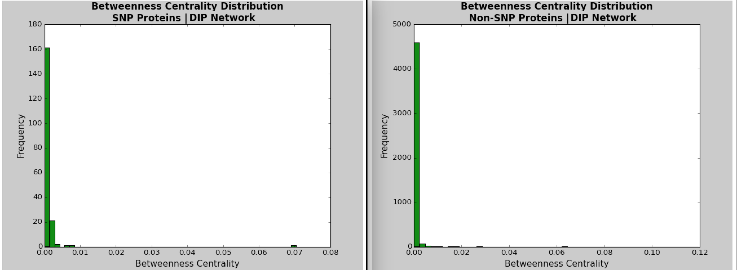
Proposed tool
Given a csv file with 3 columns (Protein Interactor A, Protein Interactor B, Weight), calculates the degree centrality and betweenness centrality for each node and outputs distribution of centrality measures
Input
Output
Notes:
Given an input csv file with three columns corresponding to protein interactor A, protein interactor B, and weights (for an example, see sample_processed.csv), Hussein's code computes the degree centrality and betweenness centrality for each node within the network. The specific documentation for each line of the code is included in Hussein's Python script.
Use DIP database as an example

Slide 8
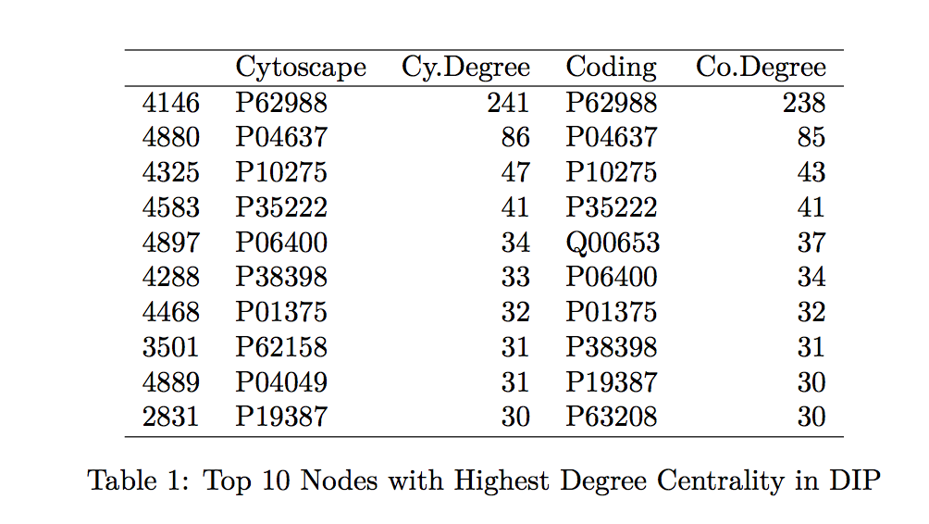
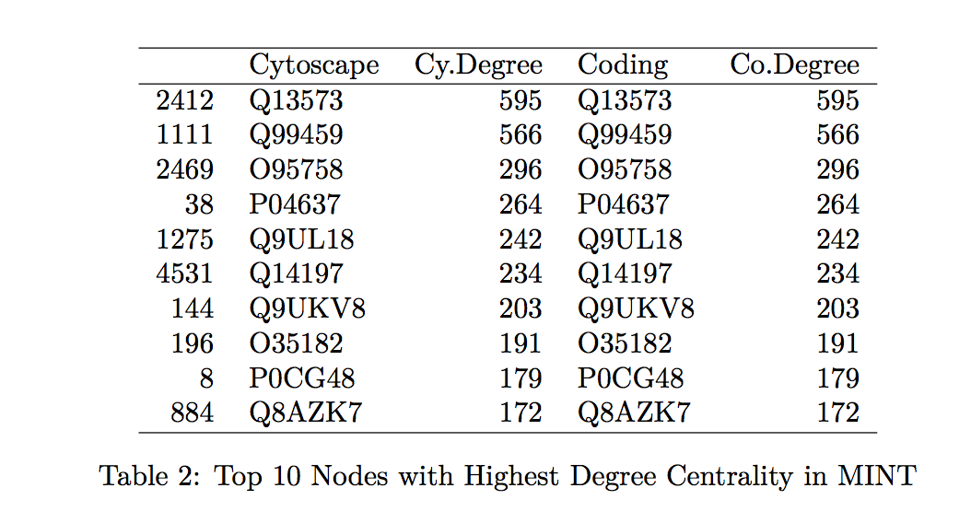
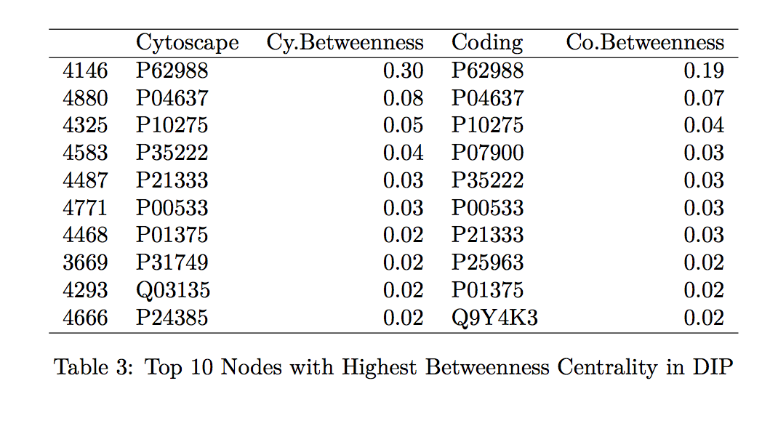
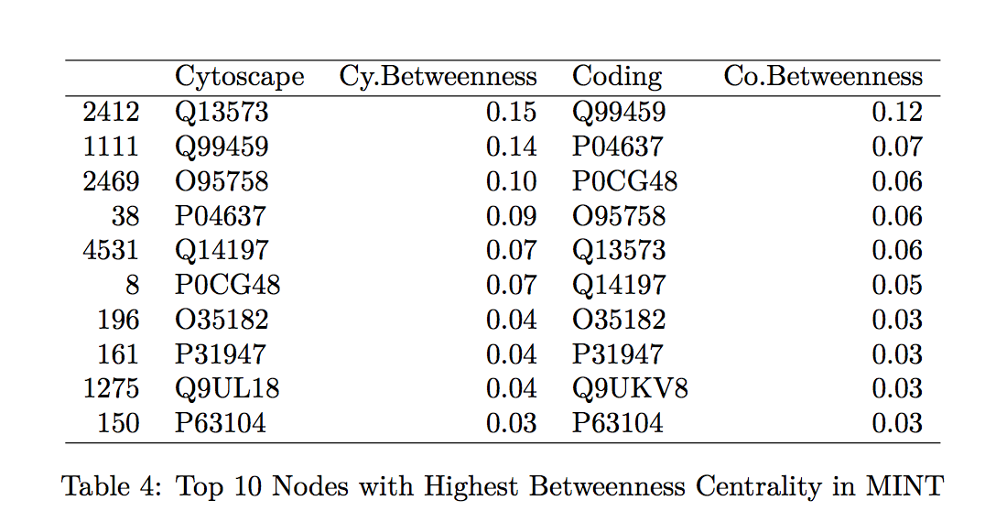
Comparison of cytoscape vs proposed tool
Notes:
To confirm that the proposed tool is a good calculator of the centrality measurements of interest, we compare the specific values generated by Hussein's code to those found by the Cytoscape program. We looked at the top 10 proteins with the highest betweenness centrality and degree centrality values within the MINT and DIP databases and compared these values between those values generated by Hussein's code and by Cytoscape (indicated in the tables by "Coding" and "Cytoscape", respectively in Tables 1-4 found in the Table Appendix).
Overall, the protein names and degree centrality values for these proteins remain relatively stable between the two programs. In our first run through, however, we noted that there were differences in the betweenness centrality calculation; specifically, the top 10 proteins from the Cytoscape software all had betweenness centrality values of 1.0. This value does not make sense as it would suggest that these nodes are included in all the shortest paths for all the node pairs (l,m). Further exploration into this issue suggested that this output of 1.0 is due to a systematic error in Cytoscape.
Running the Cytoscape software again with updates in the program resulted in the histograms and the tables shown in the appendix. Notice that there are no nodes with betweenness centrality of 1.0, and that the proteins from each software are relatively similar
Therefore, we can propose Hussein's code as a tool for calculating the degree centrality and betweenness centrality of proteins.

Slide 9
Observations on the distribution of centrality measures
Histograms follow power law distributions, not Poisson distributions, suggesting that the PPI networks are scale-free
Permutation tests show that there is no significant difference between the proteins containing and not containing SNPs
There are no SNP-containing proteins in the ten proteins with the highest centrality measures
Notes:
Now that our tool is up and running, let’s analyze the distribution of the centrality measures…
From Barabasi and Oltvai's review on network biology, we know that random networks tend to follow a Poisson distribution and scale-free networks tend to follow a power law (2004). For both the DIP and MINT databases, we see that the distribution of degree centrality follows a power law distribution rather than a Poisson distribution, evidenced by the large number of nodes with few links and a small number of nodes with a lot of classified as the hubs). With regards to the SNPs vs. non-SNP proteins, it appears that there is a higher percentage of proteins with fewer links in non-SNP proteins as compared to SNP proteins. Note: we notice that there are no counts nodes with a degree greater than 50 (as a conservative estimate). This suggests that there may be no central protein that interacts with more than 50 other proteins.
Looking at the histograms of betweenness centrality, we again see that these distributions follow the power law. This finding means that there are many nodes/proteins that are closely connected. Comparing the SNP-containing vs. non-SNP-containing proteins, we see that the betweenness centrality is more distributed in the former as compared to the latter. That is, there are more proteins with higher betweenness centrality in the SNP-containing proteins. For example, there are more SNP-containing proteins that have higher betweenness centrality (between 0.50 and 1.0) than those without, suggesting that removing SNP-containing proteins has a higher probability of disrupting the PPI network. This finding is interesting, as it implies that proteins with more centrality tend to harbor more SNPs. However, there may be potential confounding variables, such as protein size and binding site accessibility, which may require further investigation. Moreover, we have to determine whether these differences between distributions are actually statistically significant...
Permutation tests can determine whether there are statistically significant differences in the distributions of centrality measures for proteins with SNP and no SNPs. In these tests, we randomly label proteins as either having SNPs or no SNPs and compare the distributions of the means. Dingjue ran the permutation tests and found no statistically significant difference between the proteins containing Carl's SNPs and those not containing his SNPs at a significance level of $\alpha = 0.05$. Therefore, while it may seem that there are local differences in the distribution of SNP vs. non-SNP-containing proteins, there is actually no statistically significant difference among the distributions.
Why are we interested in studying the distribution of degree and betweenness centrality? According to Barabasi and Oltvai, the degree of connectedness of a protein - quantified by both the degree and betweenness centrality measures - has an important role in determining the importance of a protein within a network, i.e. would the deletion of the node have significant impact on the network structure? In a scale-free network - such as the human PPI network - a majority of the nodes do not have a major effect on the network's integrity since they (1) do not have many links (low degree centrality) and (2) are not in the "middle" of other protein interactors (low betweenness centrality). As a result, many proteins are not absolutely essential in terms of functionality.
At the same time, studying those nodes with high measures of centrality can lead to discovery of important human proteins, the removal of which can be disastrous to the system. That is, a higher centrality measurement indicates a more deleterious mutation phenotype. Using the proposed tool to compute a protein's betweenness and degree centralities within the PPI network can therefore allow for a rudimentary understanding of the mutation phenotype of said protein.
As expected, we do not observe SNP-containing proteins among the ten proteins with the highest measures of centrality (see Tables 1-4). These proteins are among the more important "nodes" within this network, and so we would expect less variability within them (therefore, less chance of having variants, such as SNPs).
On a network-wide scale, these measures are important to determine the relative distributions and connectiveness of the proteins within the PPI network.

Slide 10
Ppi network hierarchical analysis
Implement Dr. Chao Cheng’s HirNet, which resolves hierarchical network structure and calculates hierarchical score for directed networks
Notes:
We note that the PPI networks generated from the DIP and MINT databases are undirected. However,
hierarchical analyses work best on directed networks.
It was hard to find available online tools or algorithms to use that could conduct hierarchical analyses of
undirected graphs. For this section, Dingjue implemented an algorithm created by Cheng et al. called HirNet
(originally used to determine the hierarchical structure of the phosphorylome and regulome). This algorithm
resolves the hierarchical network structure and calculates the hierarchy score for directed networks. Here,
HirNet is used only to catch a glimpse of the network structure; it does not necessarily reflect regulatory
features of the PPI network.

Slide 11
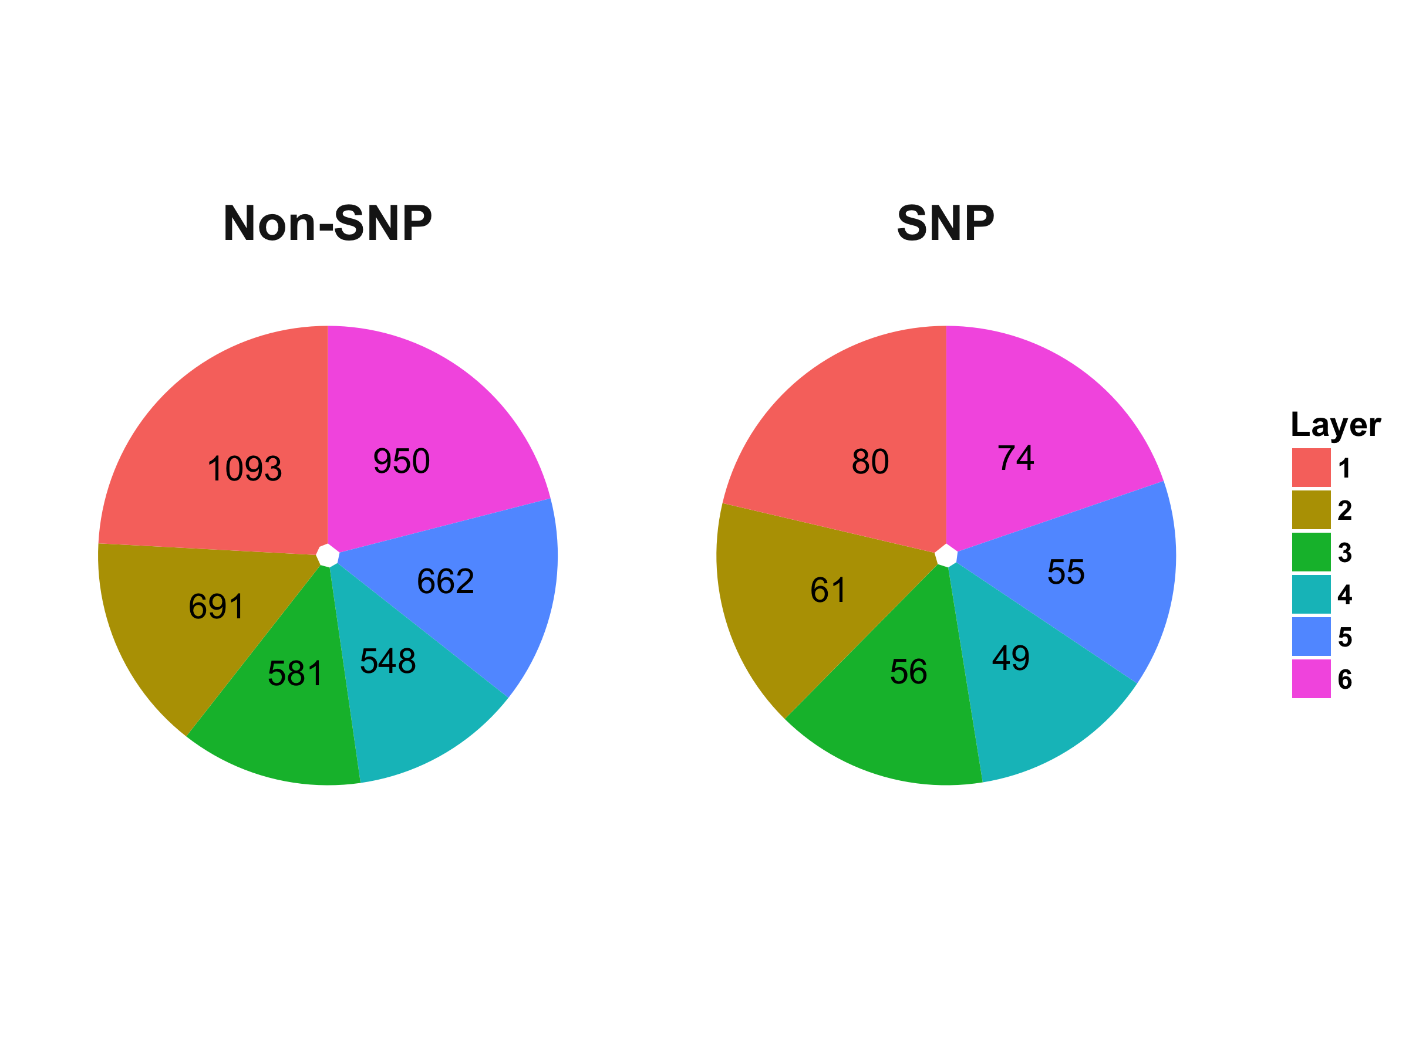
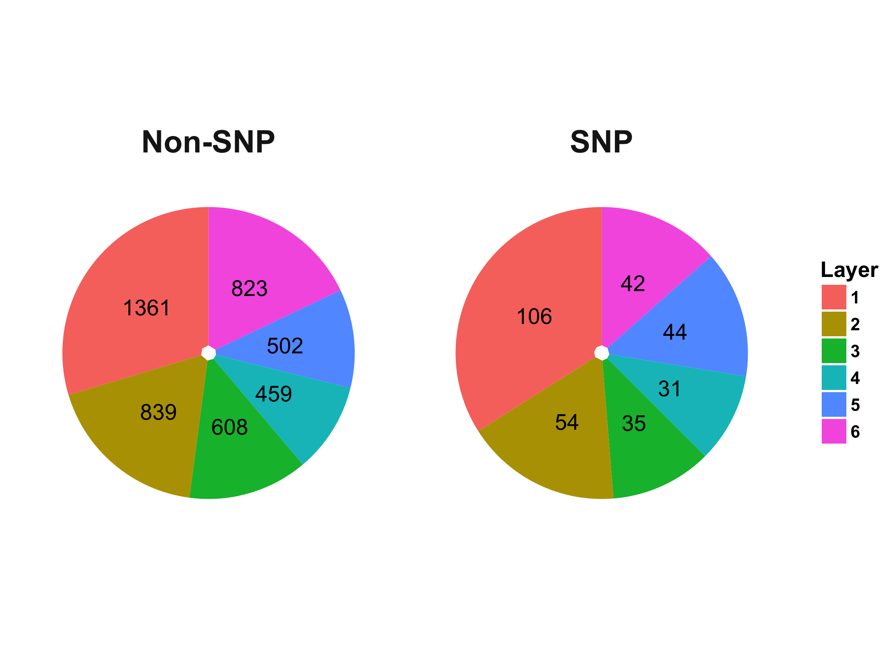
Distribution of proteins in the hierarchical layers of the ppi network
DIP
MINT
Fisher’s Exact Test yields no statistically significant difference between layers
Notes:
The DIP and MINT network have been cut into six layers. Fisher’s exact test was used to test the enrichment
of proteins with SNP in Carl’s genome in different layers. The distribution of proteins in the six hierarchical
layers is visualized below in the pie graphs
Based on the result of Fisher’s exact test (α= 0.05), there is no significant enrichment in any layers for the
PPI network, which may indicate that proteins with SNPs are not clustered or scattered in any statistically
significant patterns compared to those without SNPs

Slide 12
conclusions
Successfully proposed a new tool that calculates the degree centrality and the betweenness centrality for all nodes in the PPI network
Found no statistically significant difference in distributions of proteins containing SNPs and not containing SNPs
Observed no statistically significant enrichment of proteins/protein types in any hierarchical layers of the PPI network

